Slide 1
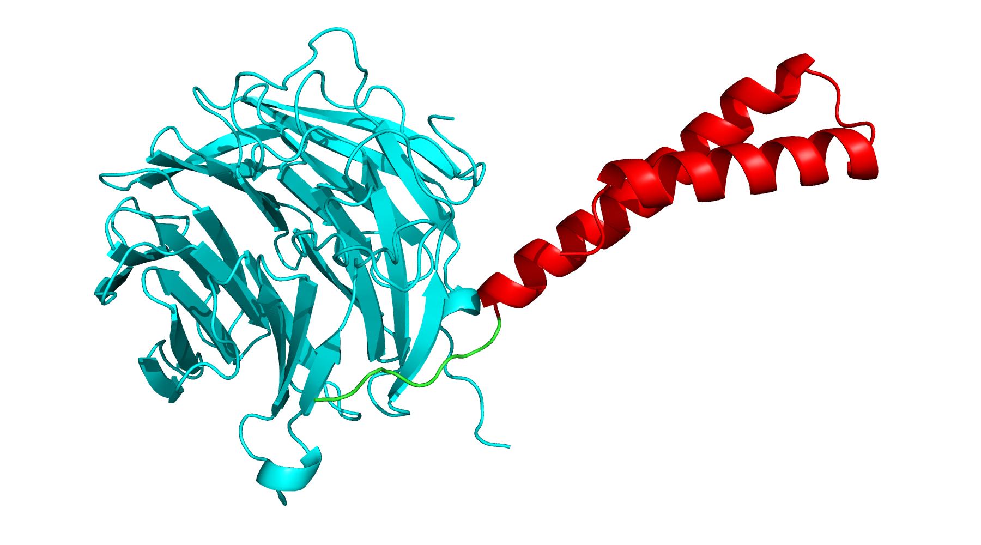
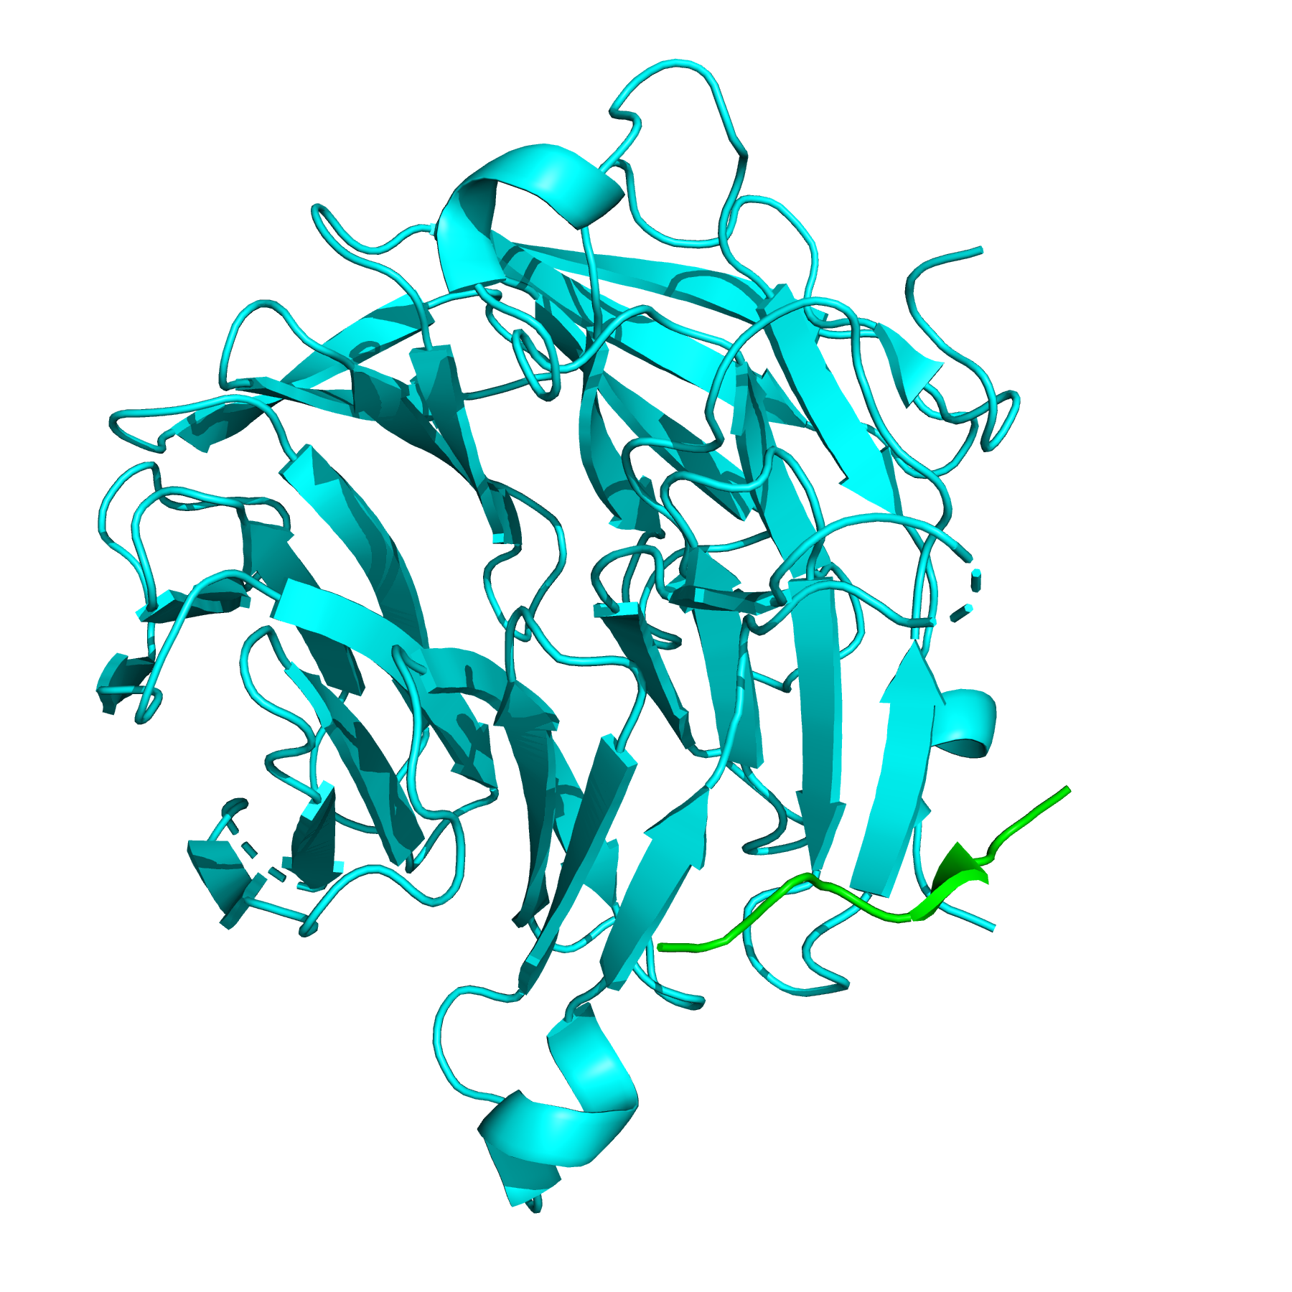
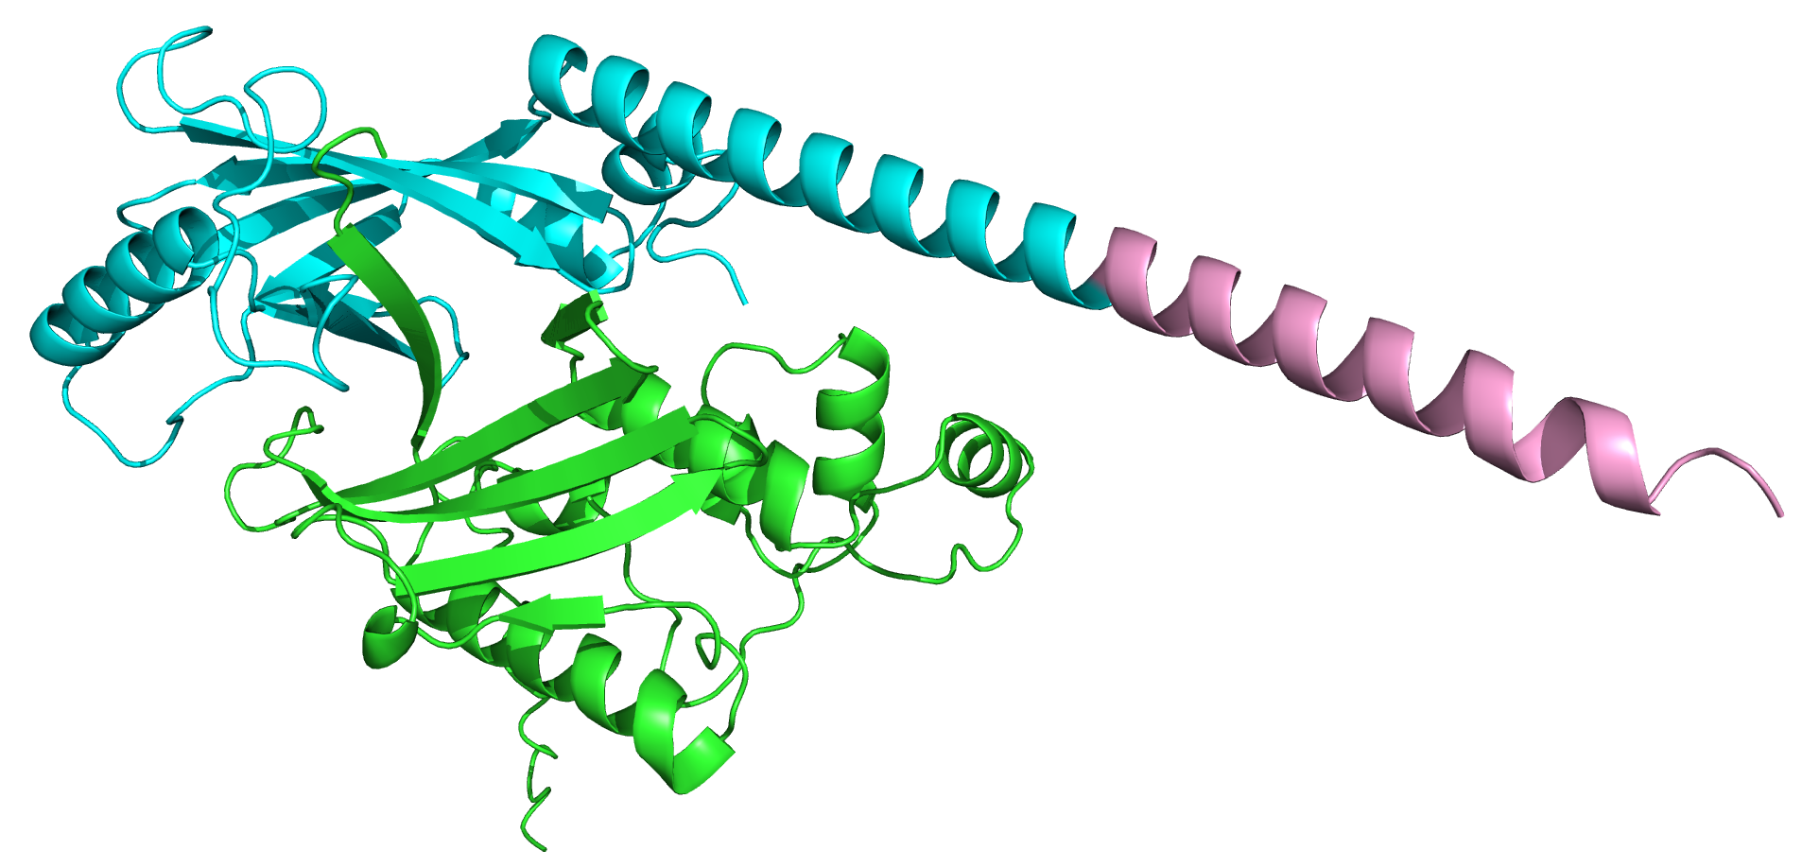
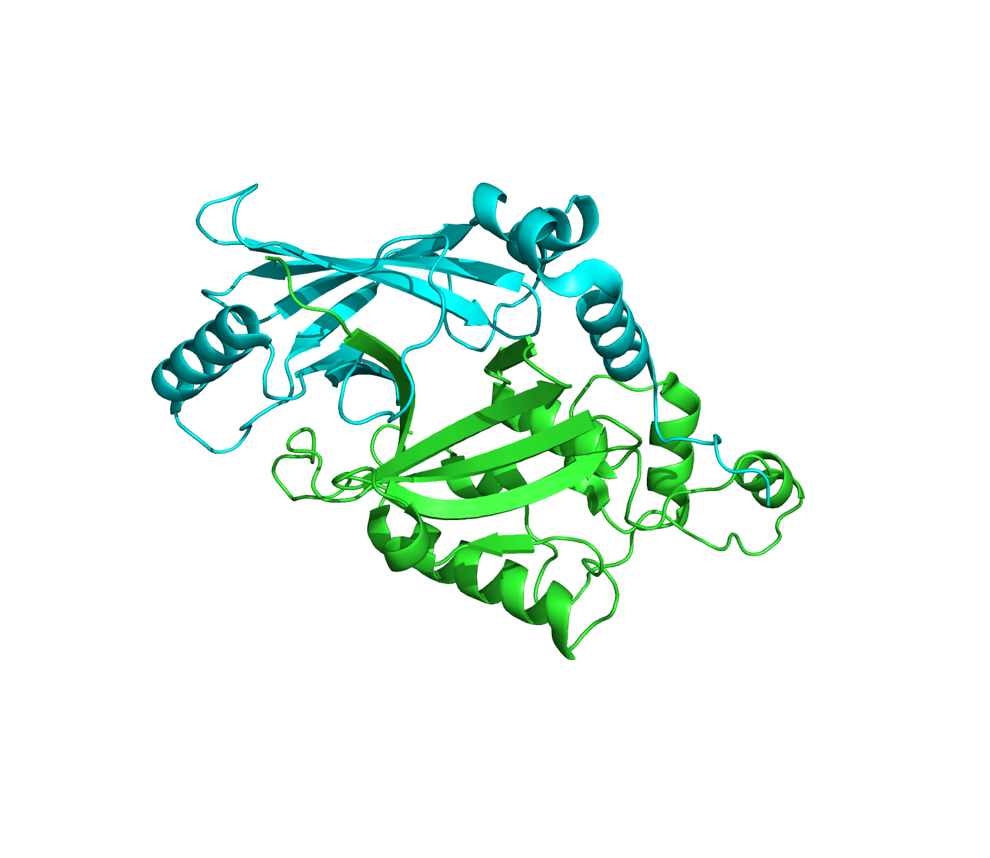
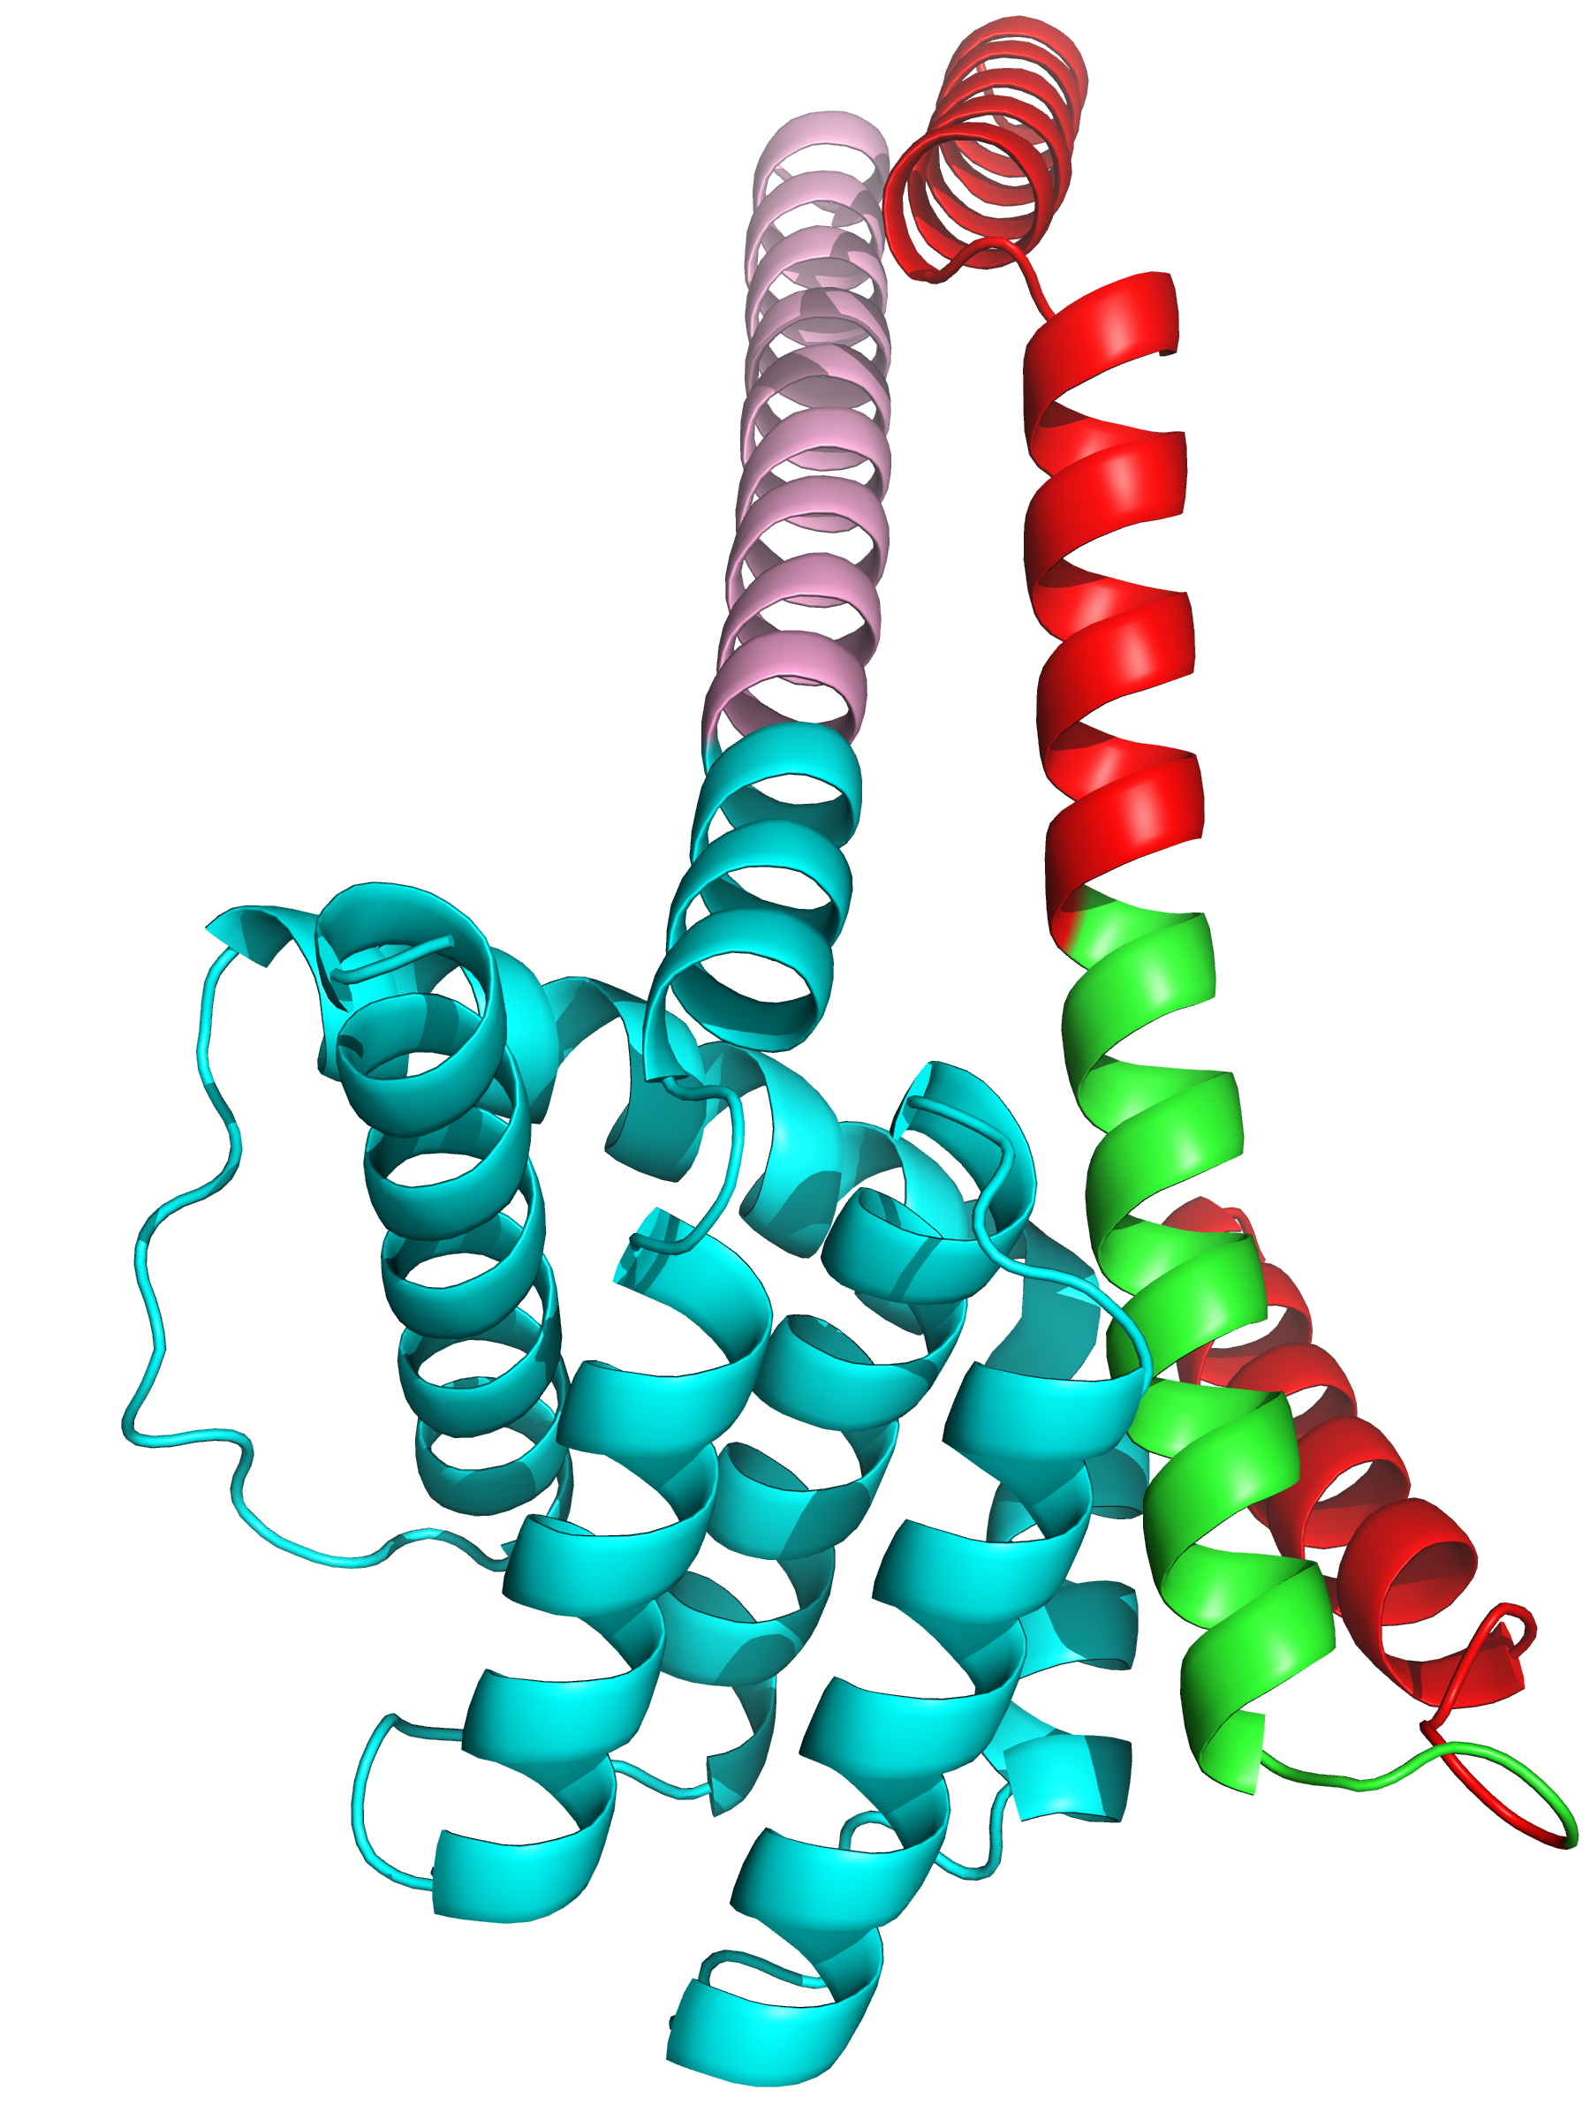
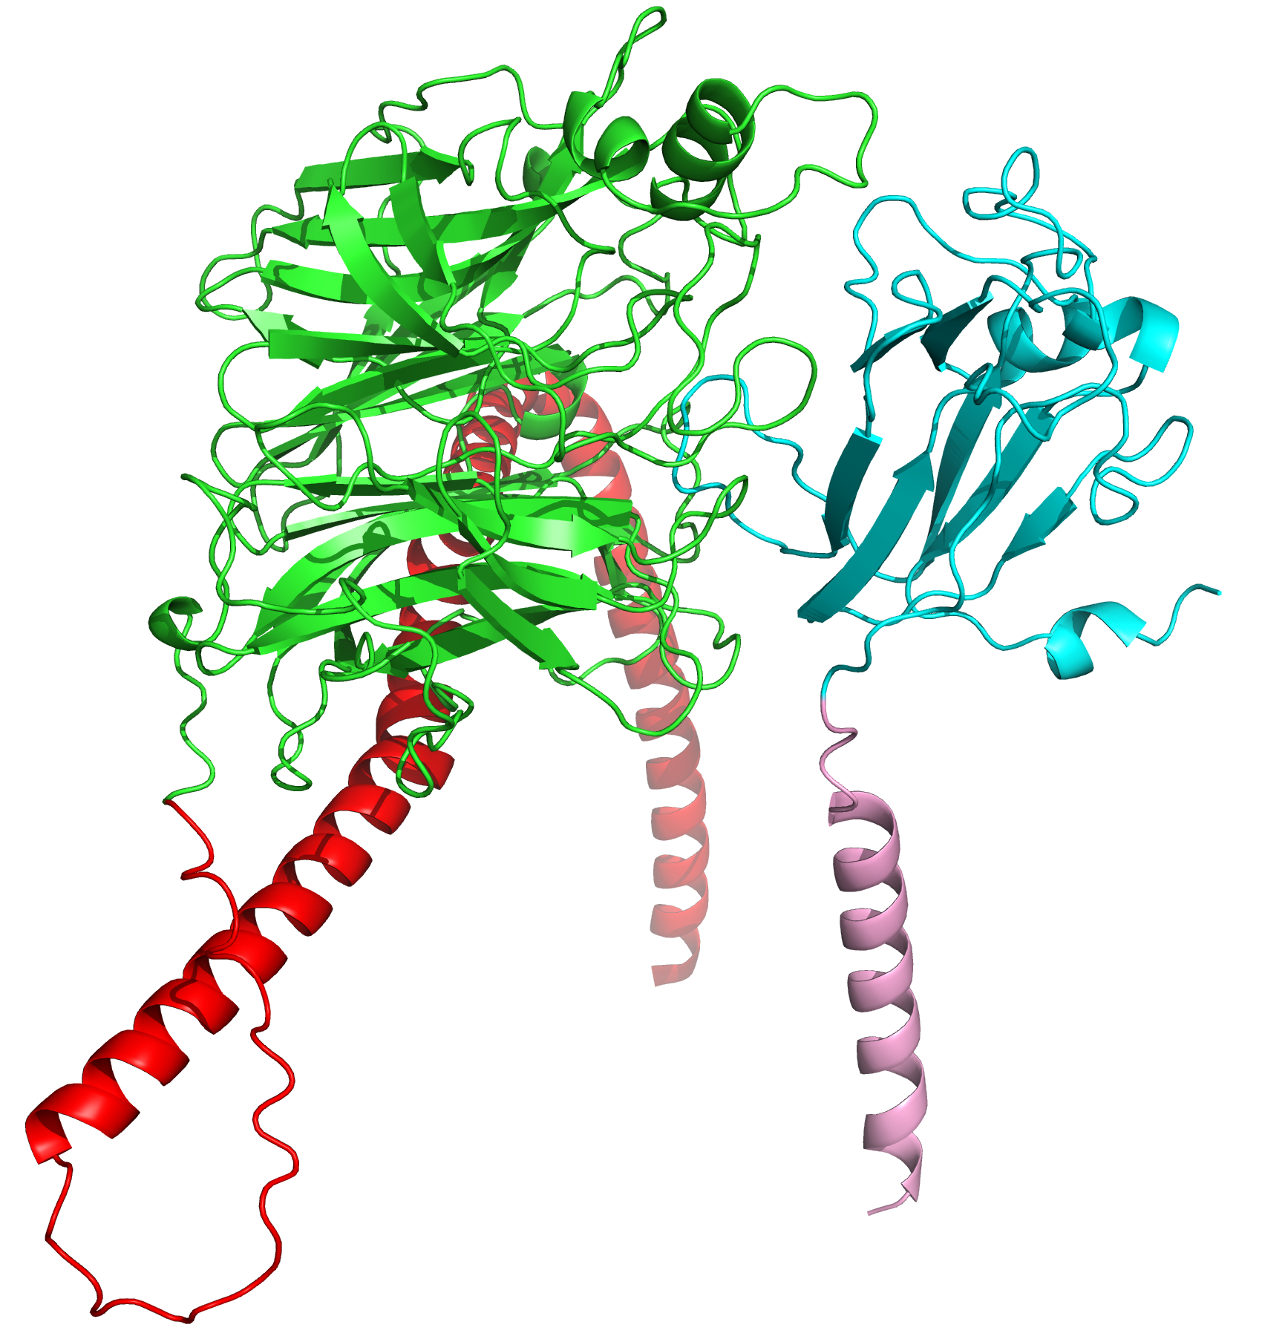
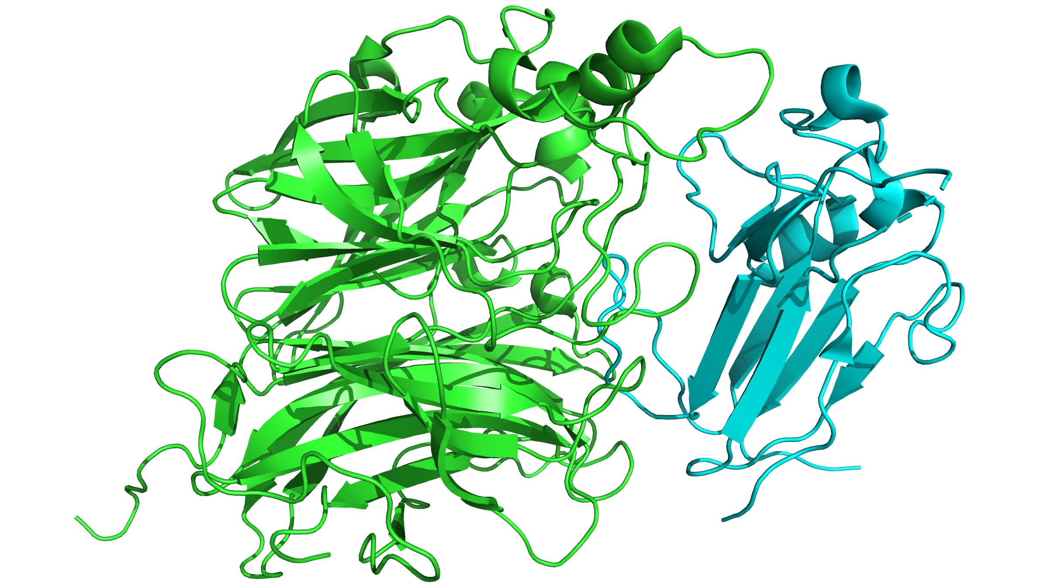
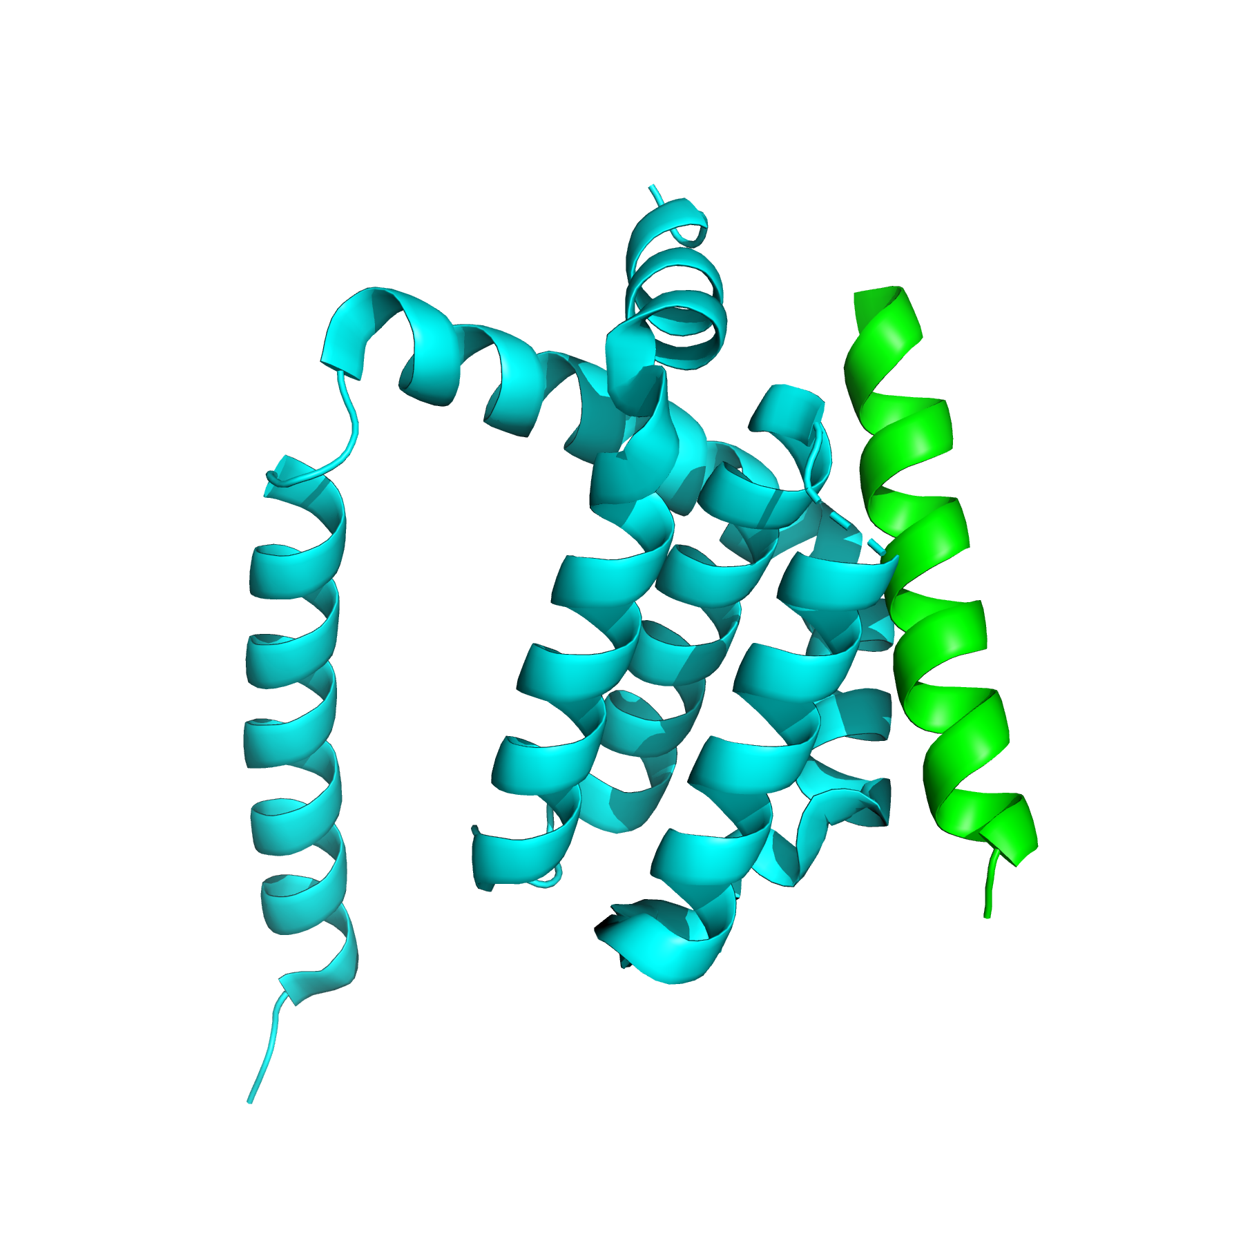
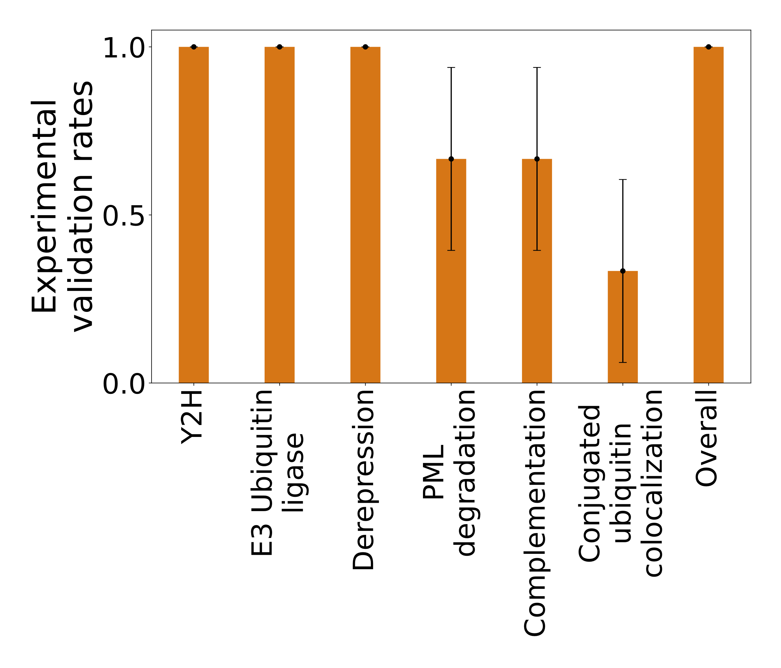
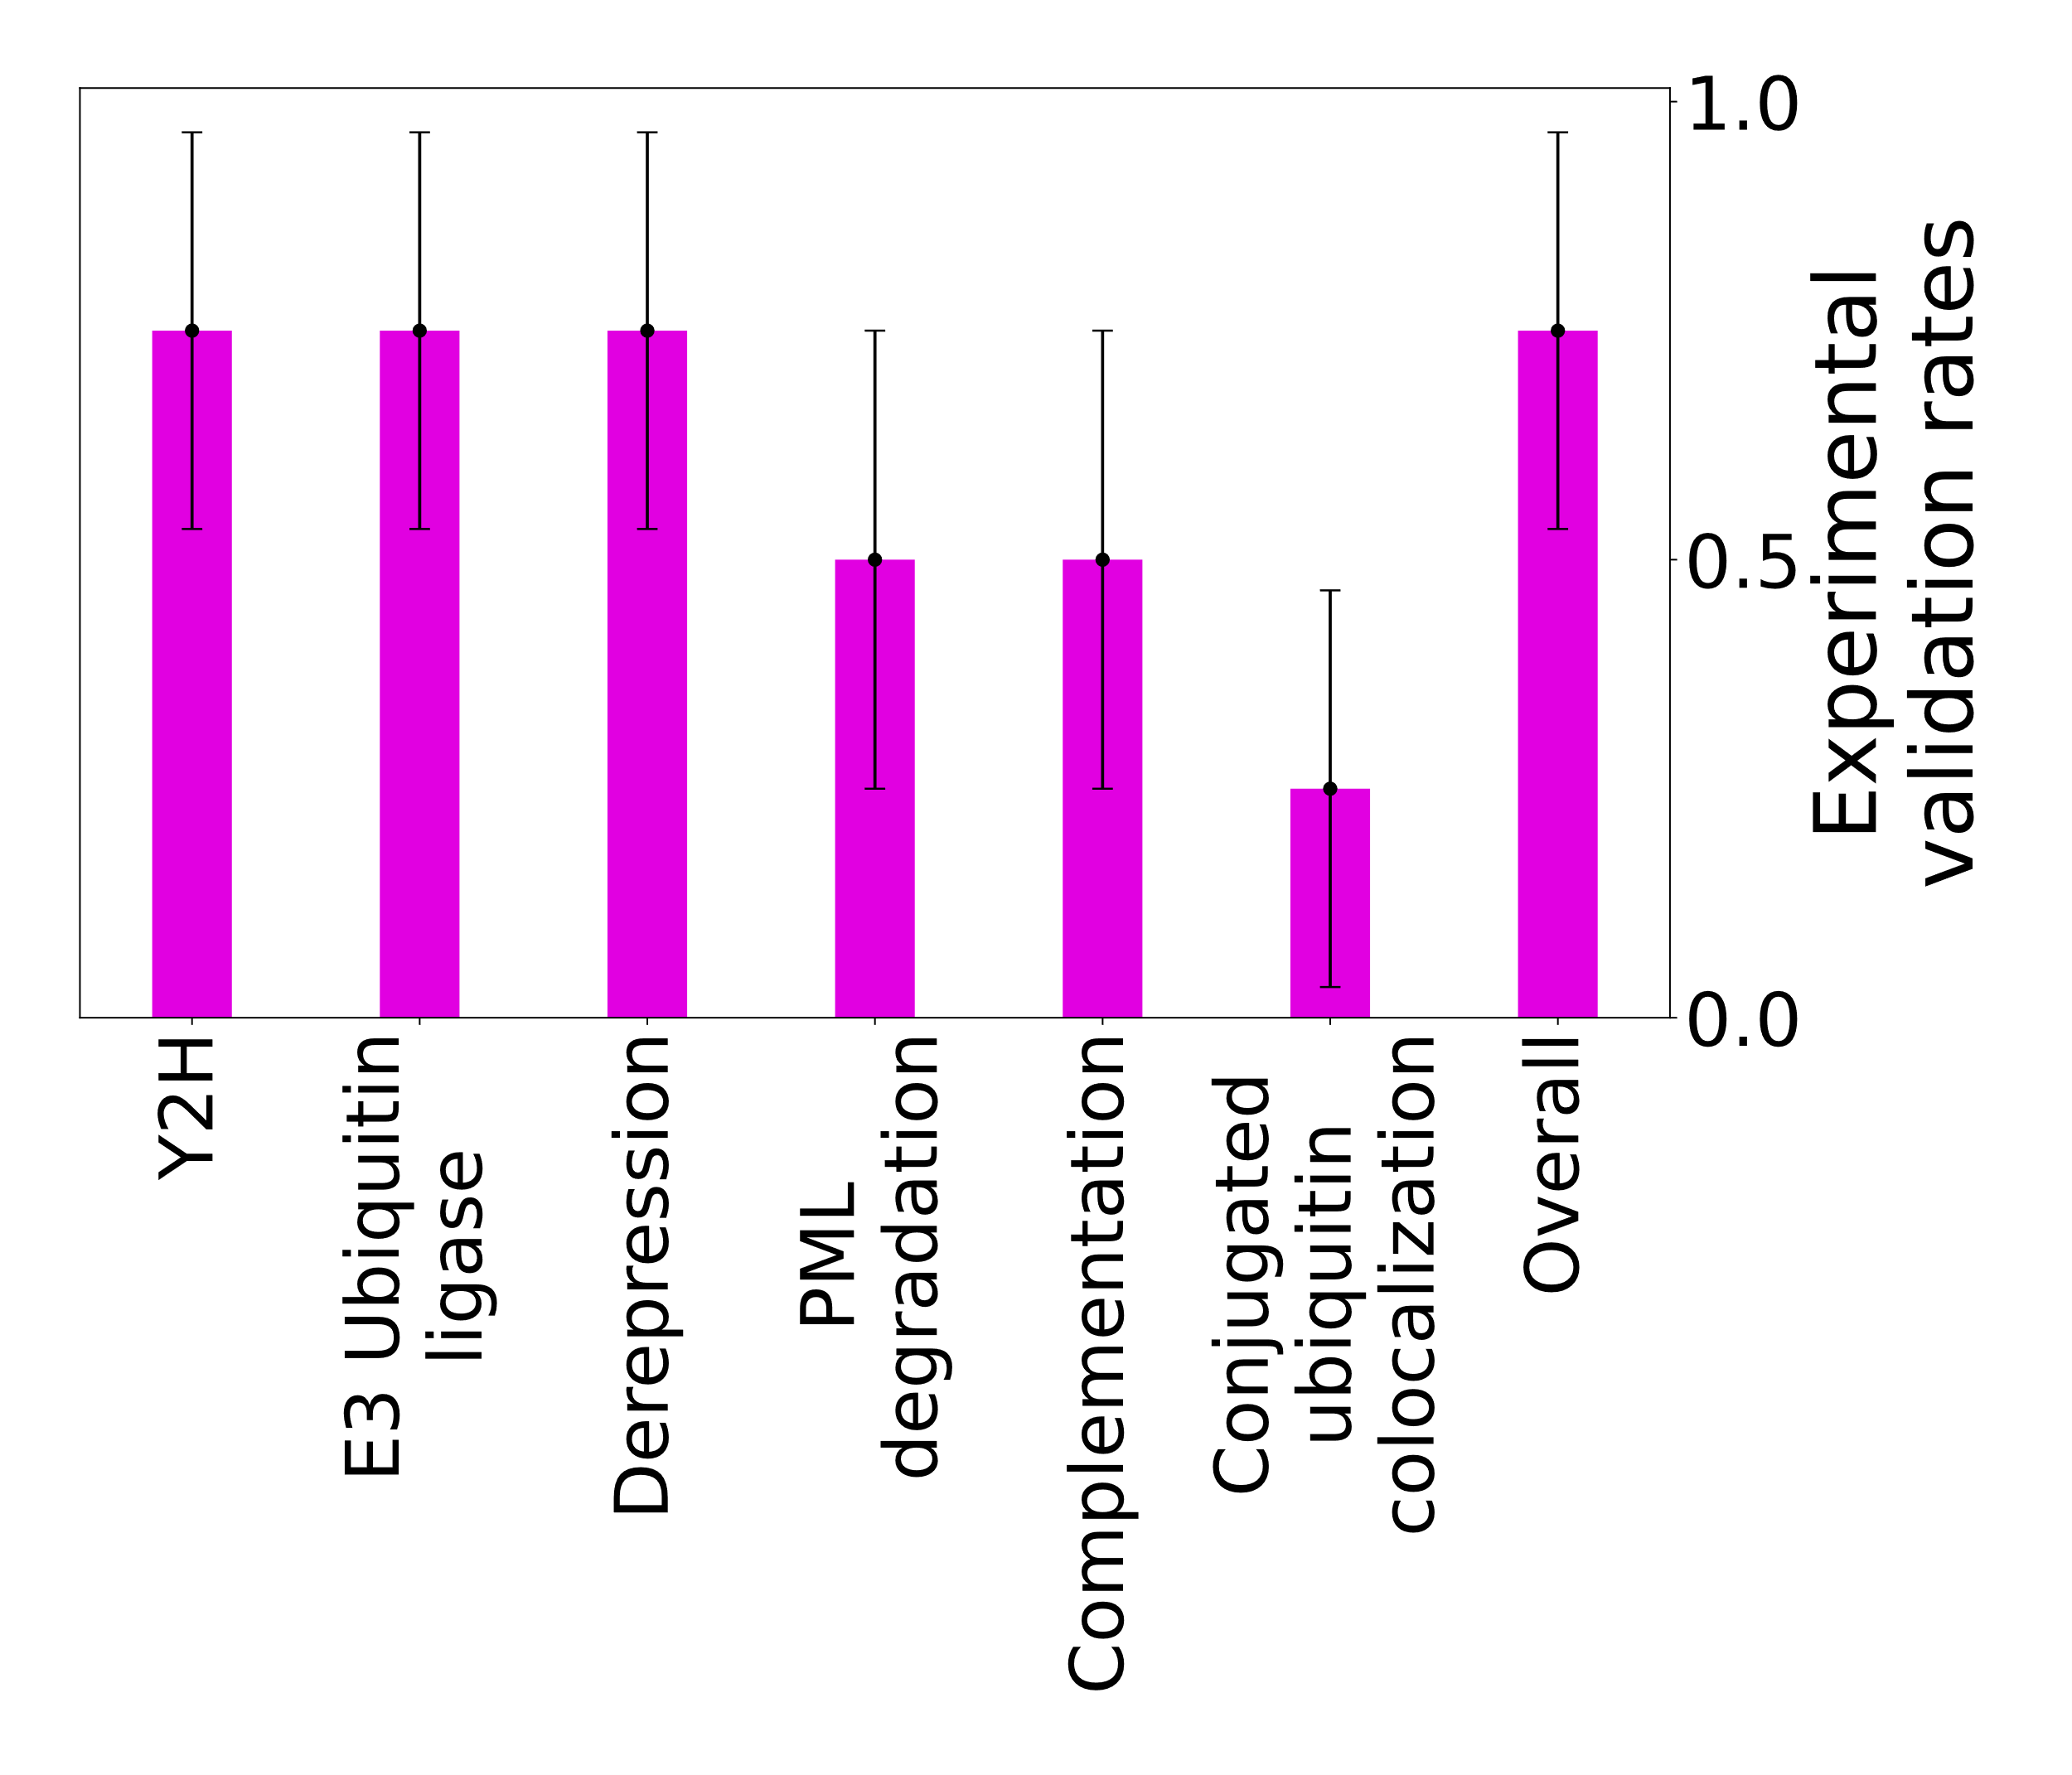
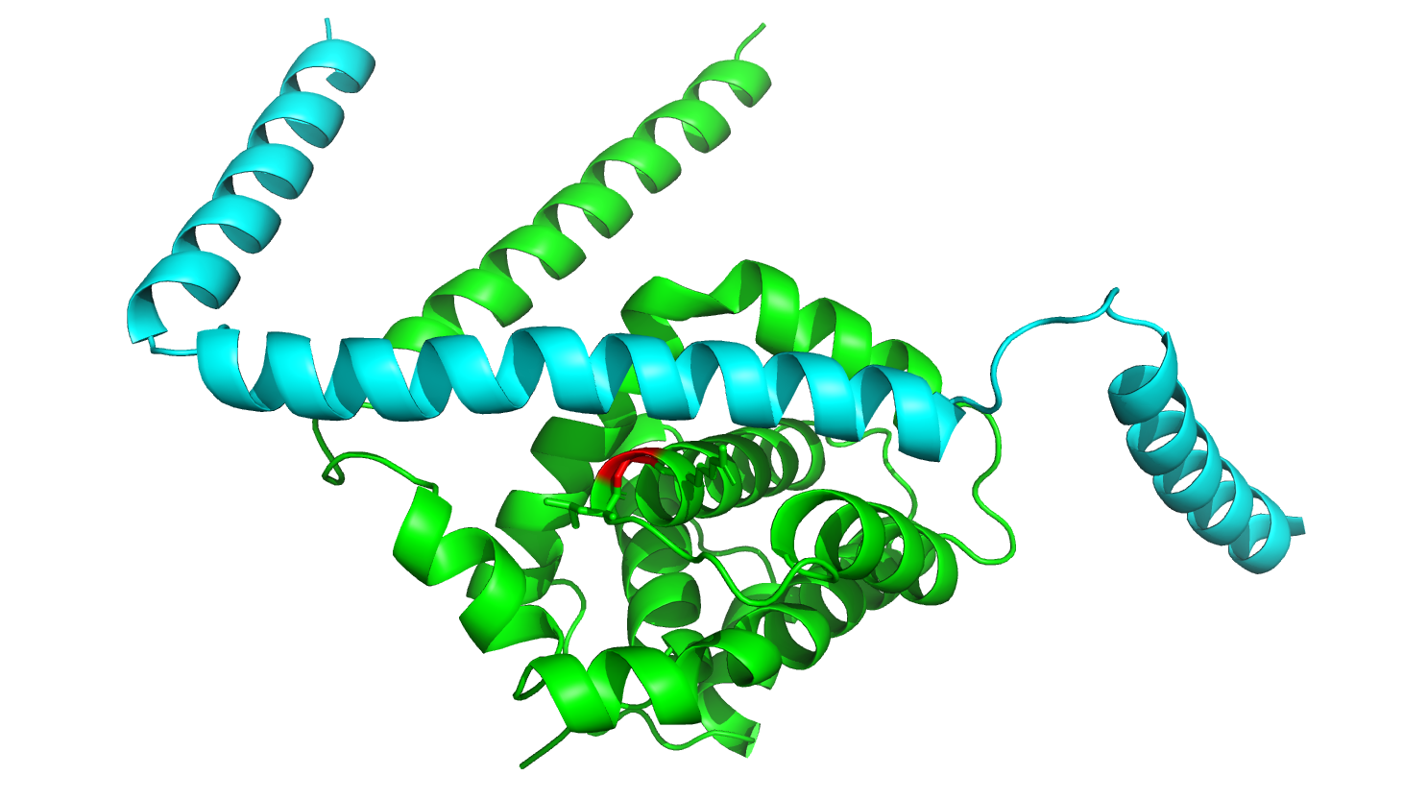
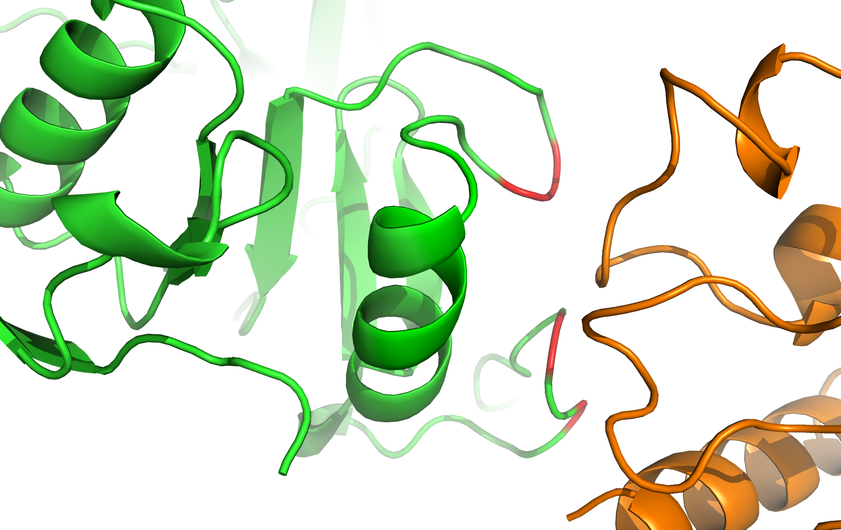
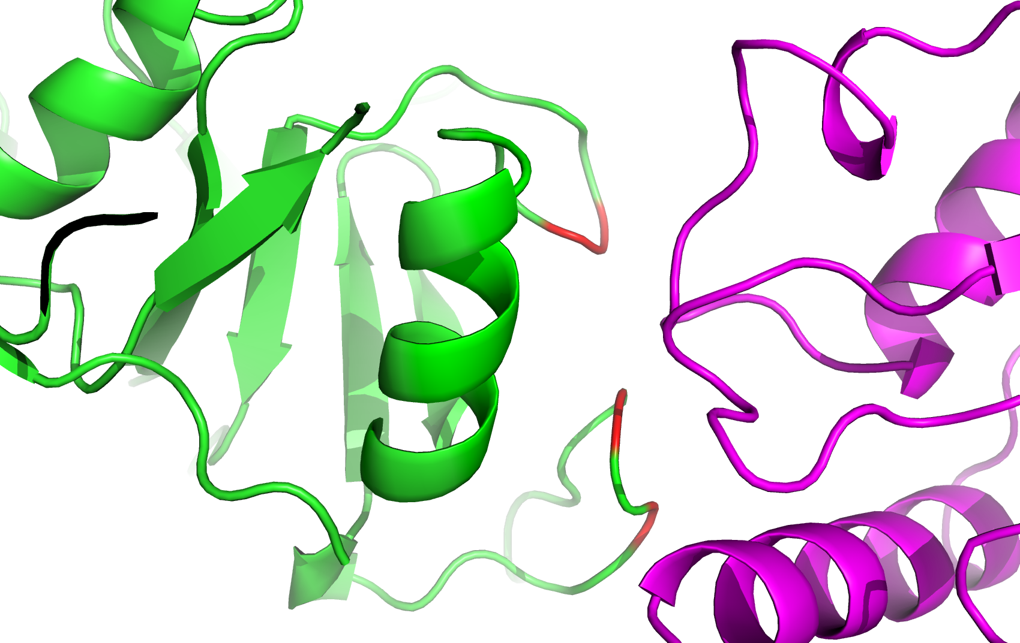
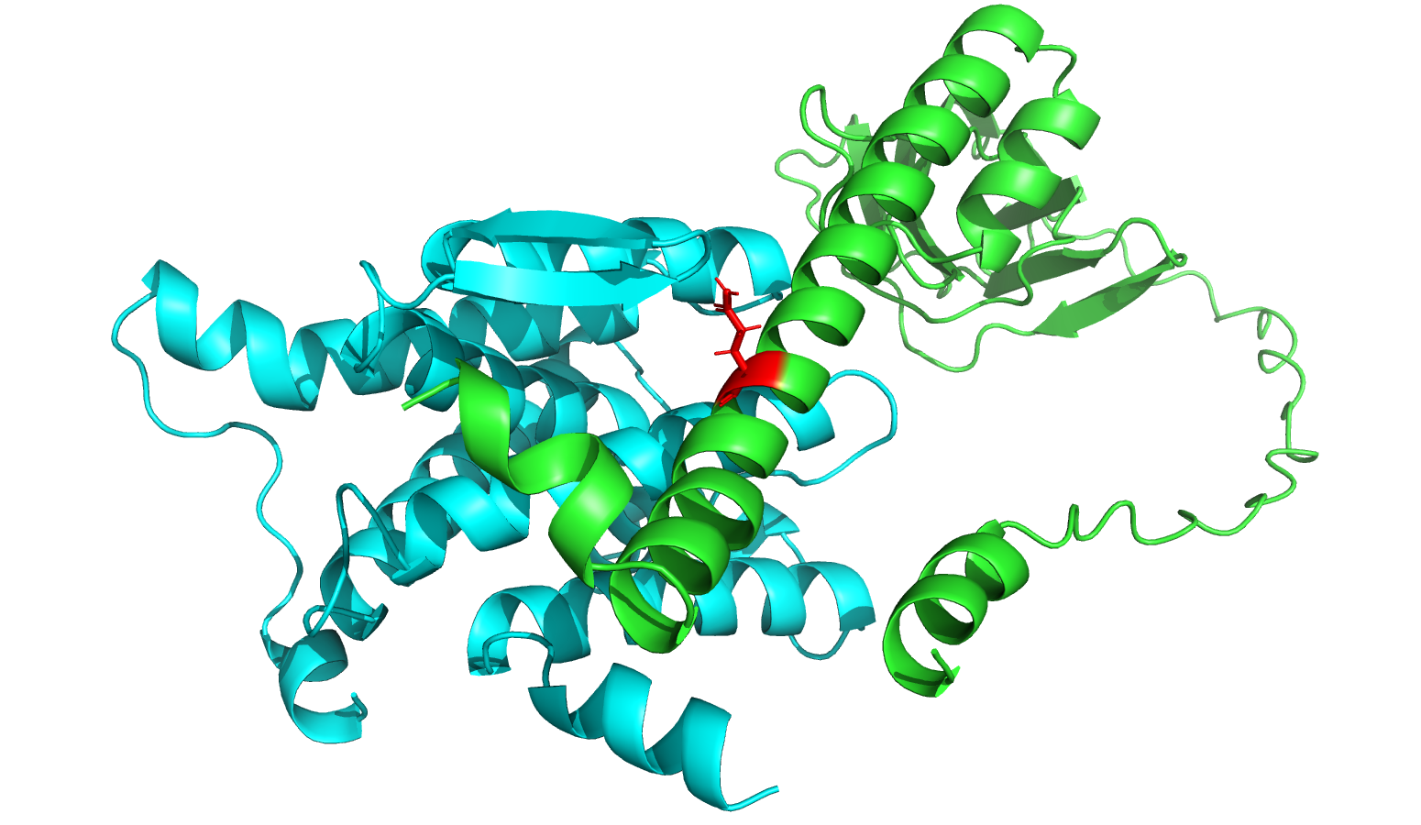
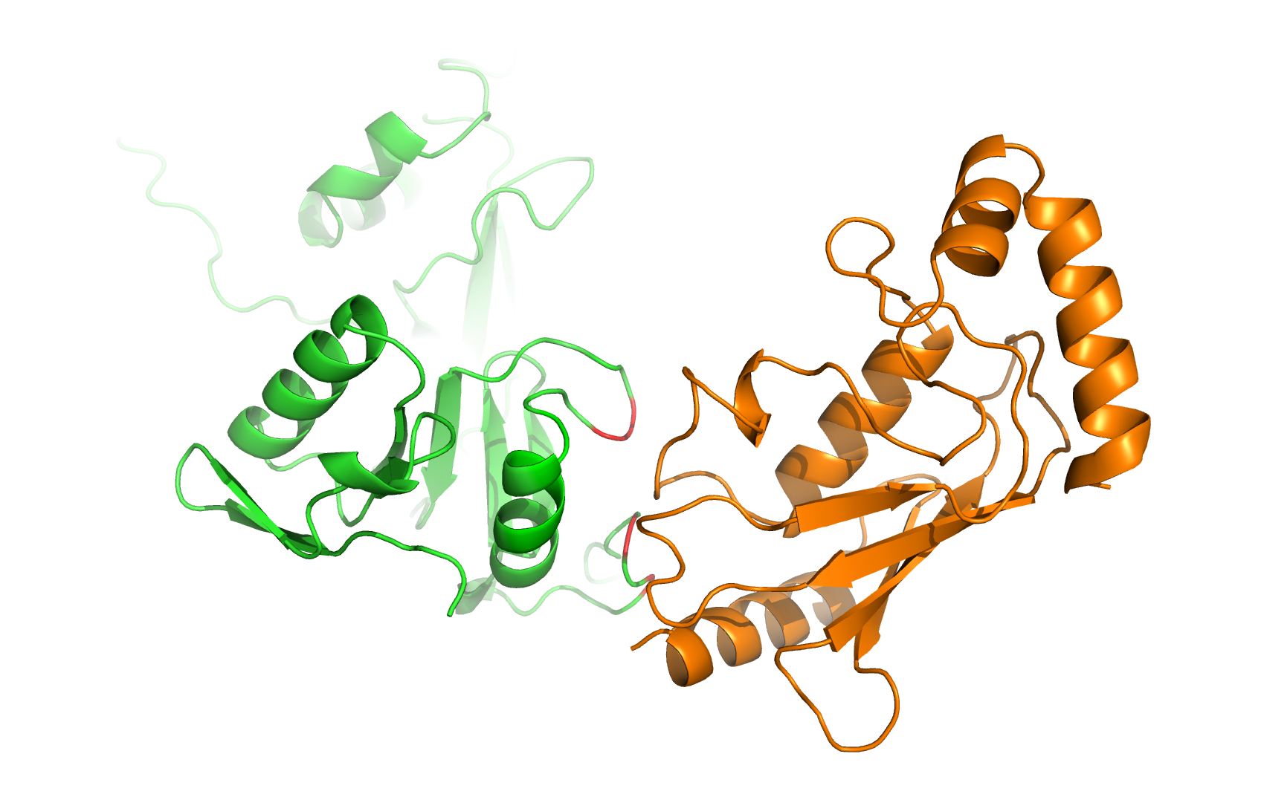
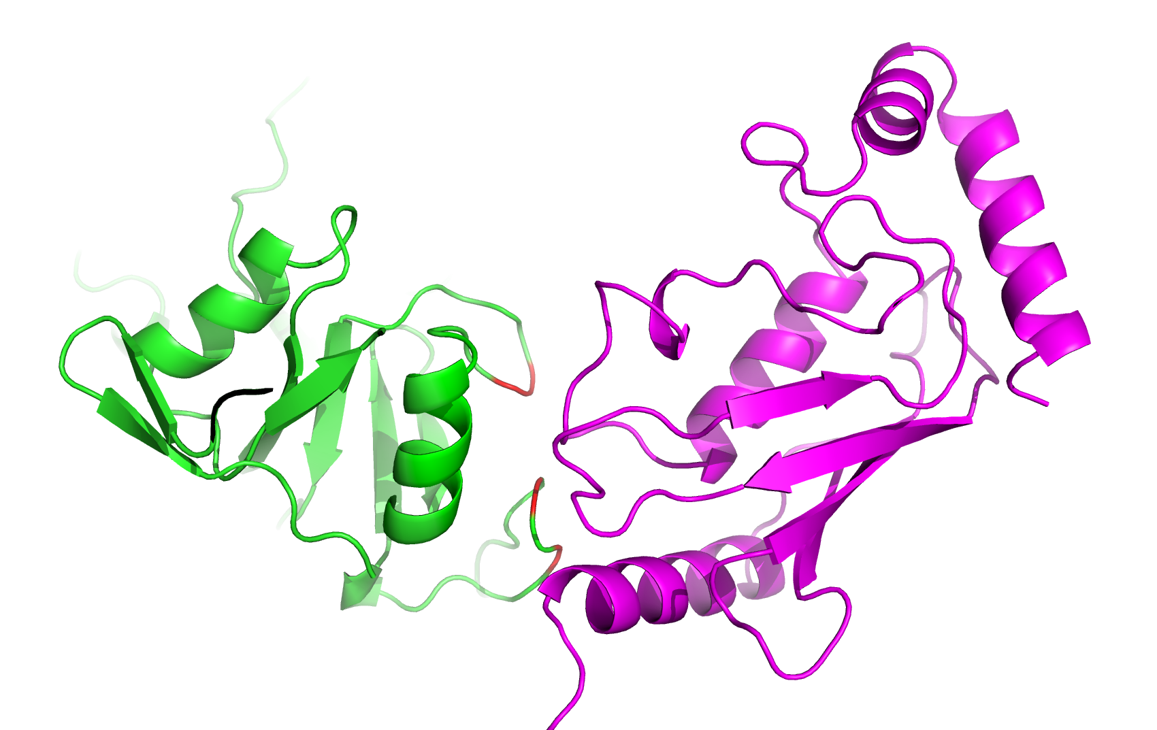
A
B
AFM prediction (Score:0.60)
TM-score: 0.99
RMSD: 0.47
PDB (7vph: J-E)
AFM prediction (Score:0.71)
TM-score: 0.83
RMSD: 1.87
PDB (8cx0: B-C)
RAE1L_HUMAN
PEBB_HUMAN
PEBB_HUMAN
NS6_SARS2
NS6_SARS2
VIF_HV1H2
VIF_HV1H2
RAE1L_HUMAN
C
D
AFM prediction (Score:0.64)
TM-score: 0.83
RMSD: 1.70
PDB (6p7y: A-B)
AFM prediction (Score:0.79)
TM-score: 0.83
RMSD: 1.17
PDB (6tqq: A-B)
G_9MONO
EFNB2_HUMAN
B2L11_HUMAN
B2L11_HUMAN
EFNB2_HUMAN
16L_YLDV
G_9MONO
16L_YLDV
E
ICP0 (HSV1) – UB2D1 (HUMAN)
ICP0 (HSV1) – UB2E1 (HUMAN)
F
B2L11_HUMAN
AFM Score:0.74
G99
EAR_EBVB9
G
P154
P154
V118
V118
DERL1_HUMAN
AFM Score:0.58
T120
T120
Q192
Predicted interface
Residues validated by Y2H
Predicted interface
Residues validated by Y2H
US11_HCMVM

